Slide 1
Analyzing Box Office Trends for Microsoft's New Movie Studio
December 10, 2023

Slide 2
Overview:
Microsoft's entry into the realm of original video content signifies a strategic move in response to the growing demand for digital entertainment. Despite being a technological giant, Microsoft recognizes its lack of experience in movie production. Hence, this project is dedicated to unraveling the complexities of box office success, specifically focusing on film genres, audience preferences, and industry trends. The ultimate objective is to equip Microsoft's new movie studio with actionable insights, enabling informed decisions in film production.
The impact of this initiative extends to various stakeholders, from shareholders anticipating market success to the committed project team responsible for delivering thorough analyses and strategic recommendations. The project's tangible outcomes encompass comprehensive reports, visually engaging data representations, and an executive presentation—essential tools guiding Microsoft's confident entry into the dynamic realm of original video content.

Slide 3
Business Unde/standing:
Microsoft's recently established movie studio is entering the highly competitive movie production industry with a primary objective—to produce films that not only captivate audiences but also generate significant box office revenue. This strategic foray into entertainment is a recognition of the industry's vast potential in the digital age.
In its pursuit, Microsoft is positioning itself as a contender against well-established studios, placing a strong emphasis on audience engagement and revenue generation. The venture comes with challenges, including navigating intense competition and addressing the diverse preferences of audiences. Microsoft's approach involves the creation of high-quality and innovative content, leveraging its technological expertise. The ultimate success of this venture hinges on the studio's ability to produce movies that strike a chord with viewers, both artistically and financially.

Slide 4
P/oblem Statement:
Microsoft is making a significant entry into the competitive arena of original video content creation with the ambitious goal of establishing a successful movie studio. Recognizing its lack of experience in the film industry, there is a crucial need to conduct a comprehensive analysis of current box office trends.
Our mission is clear: to deliver actionable insights that will serve as a guiding force for Microsoft's new movie studio. These insights are aimed at strategically informing the selection of film genres that will not only resonate with audiences but also guarantee a successful and impactful entry into the market.

Slide 5
P/oject objective:
**Objective 1: Analyze Budget vs. Revenue Relationship:**
Explore the impact of production budgets on the box office success of movies. Investigate the correlation between budget allocation and financial performance to gain insights into the factors driving profitability.
**Objective 2: Explore Genre-Based Revenue Performance:**
Examine the relationship between different movie genres and box office revenue. Identify genres that consistently contribute to higher financial returns and analyze how audience preferences may influence revenue patterns.
**Objective 3: Analyze the Influence of Release Time on Revenue:**
Investigate the effects of release timing, including seasonal trends and holiday releases, on a movie's box office revenue. Uncover patterns that indicate optimal release periods and potential factors contributing to successful launches.
**Objective 4: Provide Actionable Insights for Movie Production:**
Translate the findings from the budget vs. revenue analysis into practical recommendations for Microsoft's movie production decisions. Offer actionable insights that guide budget allocation, genre selection, and release timing to maximize box office success and audience engagement.

Slide 6
Analysis
For this analysis, data sourced from IMDB and The Number sites was integrated into a unified dataset. The key columns of interest were Production Budget, Worldwide Gross Revenue, and Genre. To facilitate the achievement of the outlined objectives, data underwent a cleaning process involving the removal of duplicates and the elimination of null values.
Correlation analysis was employed to unveil relationships between production budget and revenue. Summary statistics aided in identifying genres with the highest revenues. Additionally, it facilitated exploring the connection between release timing and revenue. The analysis employed various visualization techniques, including boxplots, barplots, and scatter plots, to illustrate data distribution and relationships among columns.
The following plots were utilized in the analysis:
1. **Boxplots:** Used to display the distribution of data, particularly focusing on revenue across different genres and release times.
2. **Barplots:** Employed to showcase the total revenue generated by each genre, offering insights into the financial performance of different genres.
3. **Scatter Plots:** Utilized to visualize the correlation between production budget and revenue, providing a clear depiction of their relationship.
The results of the analysis are interpreted below, offering insights into revenue distribution, genre performance, and the impact of production budget on financial success.

Slide 7
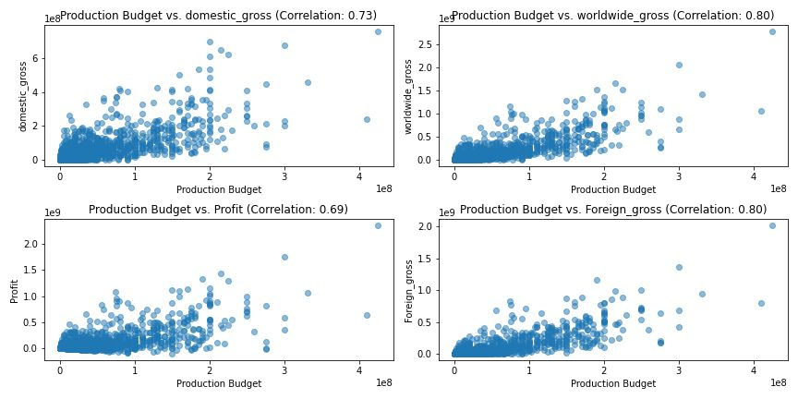
Correlation scatter plots.

Slide 8
In summary, the analysis uncovered robust positive linear relationships between production budgets and several pivotal factors within the movie industry:
1. **Domestic Gross (Domestic G/oSS):** A correlation coefficient of 0.73 indicates a strong positive relationship, signifying that as the production budget increases, the domestic gross tends to rise. In simpler terms, movies with higher budgets are more likely to earn greater revenue at the domestic box office.
2. **Worldwide Gross (Wo/ldwide G/oSS):** With a correlation coefficient of 0.80, a substantial positive relationship exists between production budget and worldwide gross. Movies endowed with higher budgets generally achieve elevated earnings in the global box office.
3. **Profit:** The correlation coefficient of 0.69 suggests a strong positive correlation between production budget and profit. As the production budget increases, movies are more likely to generate higher profits, indicating a positive association between budget size and financial success.
4. **Foreign Gross (Fo/eign G/oSS):** Similarly, a correlation coefficient of 0.80 emphasizes a robust positive connection between production budget and foreign gross. Movies with larger budgets tend to outperform in terms of worldwide box office earnings, reinforcing the positive relationship between budget size and international financial success.

Slide 9
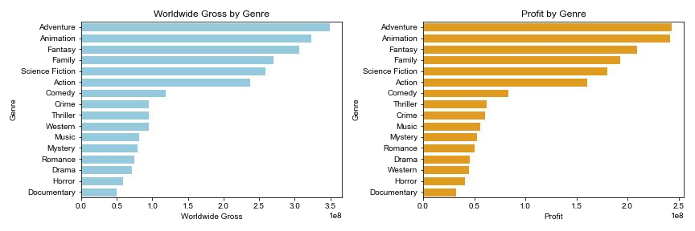
Barplots of movie genres and worldwide gross and profit.

Slide 10
The analysis of genre-based revenue performance highlights the following key points:
Top Revenue-Gene/dting Gen/eS: Adventure, animation, fantasy, and family genres consistently generate the highest total revenues and profits in the movie industry.
P/olific Gen/e P/oduction: Surprisingly, drama followed by comedy are the most frequently produced genres, indicating their broad appeal and popularity among filmmakers.
Dive/Sity of Gen/e CombindtionS: The prevalence of drama and comedy as sub-genres within various genres underscores the complexity of genre combinations in modern filmmaking, allowing for a diverse range of films. Gen/e St/dtegy ImplicdtionS: Microsoft's movie studio should consider a strategic approach to genre selection, balancing the revenue potential of popular genres with the competitive landscape they entail.
In essence, the movie industry showcases a diverse array of genres, with specific genres consistently delivering high revenues, while drama and comedy remain prolific due to their broad audience appeal.

Slide 11
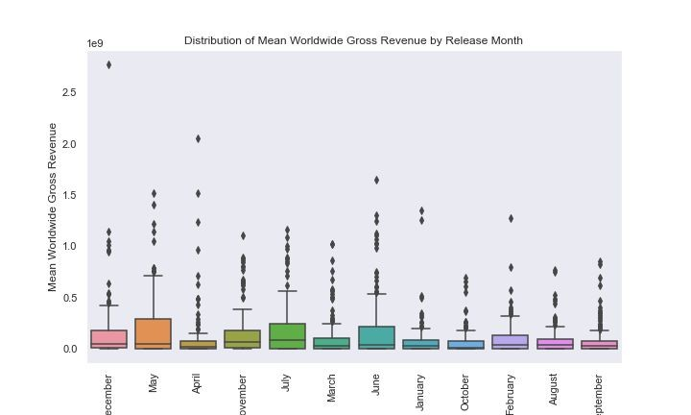
Boxplot for release month against revenue

Slide 12
The analysis of box office trends by release month provides the following insights:
BeSt MonthS fo/ ReledSeS (Decembe/, Mdy, Ap/il, Novembe/): These months are considered optimal for movie releases due to their higher median revenue. On average, movies released during these months tend to perform well at the box office. December stands out, primarily because of holiday-themed movies that attract a larger audience during the festive season, resulting in higher revenue.
G/edte/ Vd/idbility (Mdy, July, June): Months such as May, July, and June exhibit taller boxes in the box plots, indicating a greater interquartile range (IQR) and higher revenue variability among movies released during these months. This suggests that box office performance during these months can be less predictable, with some movies performing exceptionally well while others may not fare as well. Factors contributing to this variability include competition, changing audience preferences, and the timing of major movie events or holidays.

Slide 13
Wide/ Revenue Rdnge (Mdy dnd Othe/S): Months with longer whiskers, including May, have a wider range of revenue. This implies that box office performance varies more during these months, with movies achieving both high and low revenue. The broader distribution of outcomes can be attributed to factors like diverse movie genres released during these months and the influence of external events or marketing campaigns.
Overall, the analysis suggests that while summer is generally a favorable time for movie releases, specific months like December and May stand out as particularly promising for higher box office revenue. However, a more detailed understanding of genre preferences and audience demographics is essential to fully leverage this seasonality information for revenue maximization.

Slide 14
Conclusions.
Based on the analysis findings, we offer actionable insights to guide Microsoft's new movie studio in its entry into the movie production industry:
Strategic Investment: The analysis reveals that higher production budgets can lead to better box office performance. However, it's crucial to allocate budgets strategically, considering genre and release timing. Microsoft should ensure efficient budget allocation to maximize returns.
Genre-Centric Approach: Genres play a significant role in revenue generation. Microsoft should focus on producing movies in genres that have consistently performed well at the box office. Stay adaptable to evolving audience preferences and emerging trends.

Slide 15
3. Release Timing Strategy: The timing of movie releases is pivotal. Microsoft should create a well-planned release calendar, capitalizing on months like December, May, April, and November. Pay close attention to seasonal trends and avoid months with high revenue variability, such as May, June, and July.
By following these recommendations and maintaining a data-driven, adaptable approach, Microsoft can position itself for success in the dynamic and competitive movie production industry.

Slide 16
Recommendations
In the future, we recommend:
Data Enhancement: Focus on collecting additional data in areas where it is currently missing, such as comprehensive audience feedback and demographic data. This will provide a more comprehensive understanding of the audience and also the specific release times in days so as to be able to get a good grasp of the data for analysis
Ongoing Market Monitoring: Continuously monitor industry trends, audience preferences, and box office performance. Adapt strategies to changing dynamics and evolving tastes.
Data-Driven Decision-Making: Continue to use data analytics and insights to guide production decisions. Utilize predictive modeling to assess potential box office performance, optimize release timing, and tailor content to audience preferences.

